Slide 1
Overview of the CO₂ Storage Resources Management System Guidelines
Prepared for the Society of Petroleum Evaluation Engineers
By
Scott Frailey
and
Marshall Watson

Slide 2
Outline
CCS Status and Outlook
SRMS Background: intended users, purpose, development process
Storable Quantities
SRMS and SRMS Guidelines: table of content comparison
SRMS Structure: Classification and Categorization
Comparison to PRMS
Notable addition in Guidelines: Containment
Example Applications
Other Considerations

Slide 3
Biden Administrations Priorities
2022
2030
50% emissions reduction
2035
100% clean electricity
2050
Net-zero carbon emissions

Slide 4
Renewables consumption grows fastest but remains far below petroleum and other liquids consumption in 2050
Energy consumption by fuel
AEO2022 Reference case
quadrillion British thermal units
Energy consumption by sector
AEO2022 Reference case
quadrillion British thermal units
Note: Biofuels are shown separately and included in petroleum and other liquids.

Slide 5

Senate energy and water appropriations subcommittee
(Majority and Minority)
6.5 billion for carbon capture and storage-Infrastructure Bill
EOR is unpopular with environmental group
In light of war in Ukraine, we need to ensure energy security both for U.S. and Europe.
Need to produce more oil and gas in a responsible manner
Blue and green hydrogen supported

Slide 6
Dr. Sally Benson: Deputy Director for Energy, Office of Science and Technology Policy at the White House; Chief Strategist for the Energy Transition
Pathways to net-zero include CCS (Carbon Capture and Storage) and CDR (Carbon Dioxide Removal)
Hydrogen is number one way to achieve goal
Skills and science/engineering capabilities in PE are relevant for many applications
  H2 storage
  CO2 storage
  CS with EOR
  Improved recovery from brownfields
  Solution mining for critical materials
  geothermal

Slide 7

Lifecycle of a CCS Project
Capture
Transport
Storage
Characterization & Design
Permit
Construction
Operations
Closure &
Post-Closure
Long-Term Stewardship
Storage (Sequestration) Phases
1-2
2-3
3-4
12-50
Defined
Indefinite
Cumulative Time (Years)

Slide 8
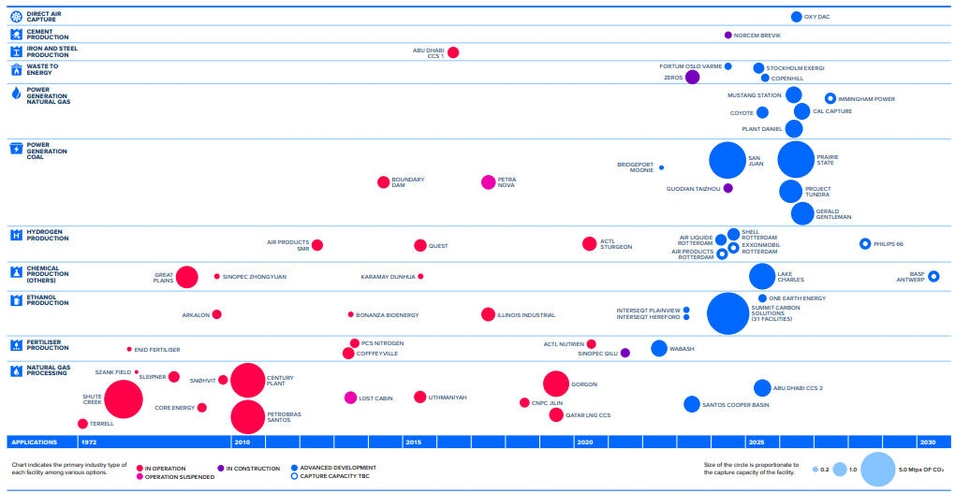
Courtesy: Global CCS Institute: 2021 Global Status of CCS Report

Slide 9
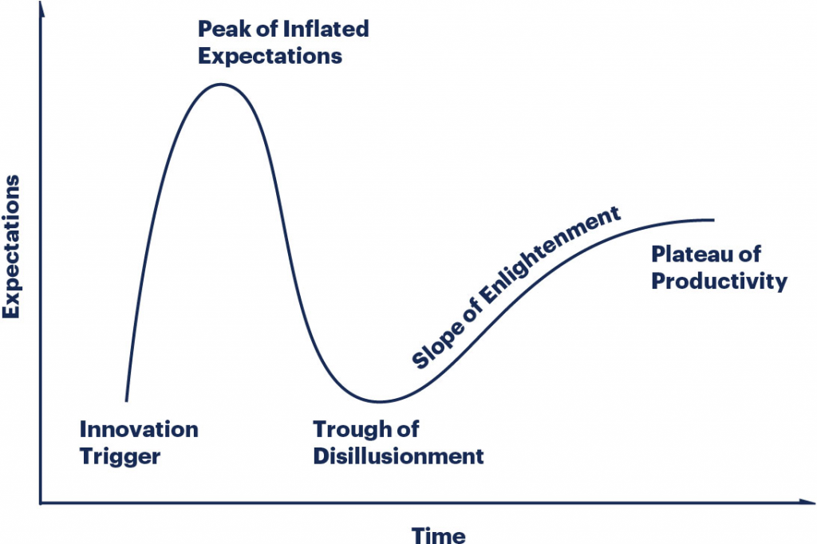
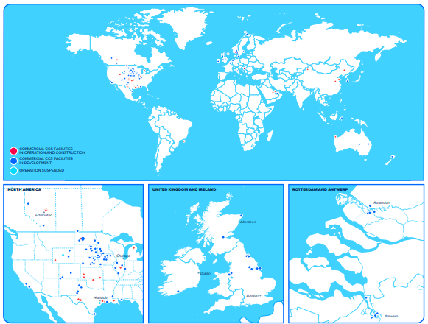

Gartner Hype Cycle
 | Number of facilities | Capture Capacity (Mtpa)
Operational | 27 | 36.6
In Construction | 4 | 3.1
Advanced Development | 58 | 46.7
Early Development | 44 | 60.9
Operation Suspended | 2 | 2.1
Total | 135 | 149.3
World Map of CCS facilities at Various Stages of Development
Courtesy: 2021 Global Status of CCS Report

Slide 10
Storage Resources Management System (SRMS)
Intended Users and Purpose
Commercial scale CO₂ storage projects involving financial, corporate, government organizations
  SRMS provides common terminology and clear definitions needed to classify storable quantities in the context of defined projects
  SRMS provides context for investment and tracking the performance of the investment
Applicable to regional or basin resource assessments via a notional storage project
Intended for brine aquifers and abandoned oil and gas reservoirs

Slide 11
SRMS and SRMS Guidelines: Development Process
SRMS Seed Document
  Petroleum Resources Management System (PRMS)
  Time tested and applied system
  Supported by financiers, security exchanges, and governments (world)
Committee selection
  PRMS and storage experts
Fall 2017: SRMS Published by SPE
Summer 2021: Sponsoring Societies
  SPE, SPEE, AAPG, EAGE, SEG, SPWLA, WPC
February 2022: First published commercial usage:
  Santos booked, with external auditors:
    100 Mt of CO2 Capacity, at 1.7 Mt/yr
    1.2-1.6 B$
June 2022: US DOE requests storage projects follow SRMS in development of CO₂ storage hubs
June 2022: SRMS-Guidelines
  Nearly 5 mos delay due to SPE desire to sell on SPE webstore and undisclosed SPE-IT challenge(s).

Slide 12
Storage Resources Management System (SRMS)
Storable Quantities
Projections of storable quantities are essential part of all storage projects
  Estimated Ultimate Storage (EUS)
Storable quantities: the commodity of storage industry
  Quantities of CO₂ that can be stored as part of an estimated pore volume of a geologic formation that is accessible to CO₂ via a storage project sometime in the future
  Requires containment
  Directly related to a defined project

Slide 13
Storage Resources Management System (SRMS)
Committee
SRMS Guidelines Chapter Leads
SRMS Guidelines Committee (active)
Ch 1: Owain Tucker, Scott Frailey
Ch 2: Karin Ask, Scott Ayash
Ch 3: Lesley Rantell, Marshall Watson
Ch 4: Sylvain Thibeau, George Koperna
Ch 5: Tracy Rodosta, Steve Whittaker
Ch 6: Jacqi Rouche, Paul Johnson, Isis Fukai
Ch 7: Lesley Rantell, Owain Tucker, Scott Frailey
John Ritter, Roland Okwen,
Fang Yang, Tip Meckel,
Neeraj Gupta, Subash Thakur

Slide 14
SRMS and SRMS-G Table of Content Comparison
SRMS Chapters
SRMS Guidelines Chapters
Basic Principles and Definitions
Classification and Categorization
Evaluation and Reporting
Estimating Storable Quantities
Introduction
Classification and Categorization
Project Evaluation and Reporting
Estimating Storable Quantities
Analogy and Differences to PRMS
Data Used to Characterize a Geol. Formation for Storage Project
Case Studies and Examples of Storage Resource Classification

Slide 15
SRMS Structure:
Classification of Storable Quantities
Based on Project Maturation
Specific to a Defined or Notional Project
Discovered vs. Undiscovered
  storable quantities for which one or more wells established through testing, sampling, and/or logging the existence of a quantities sufficient to meet project requirements.
Commercial vs. Sub-commercial
  essential social, environmental, and economic conditions are met, including political, legal, regulatory, and contractual conditions.
  degree of commitment is such that storage project is expected to be developed and placed on injection within a reasonable timeframe.
Total Storage Resources
Discovered Storage Resources
Undiscovered Storage Resources
Commercial
Sub-Commercial
Contingent Storage Resources
Prospective Storage Resources
Capacity

Slide 16
SRMS Structure:
Categorization of Storable Quantities
Categorization: Storable Quantity Certainty
Based on defined project, but NOT the project’s maturity
Major Categorizations
  Low estimate
    High probability
    P₉₀
  Best estimate
    Most-likely (median)
    P₅₀
  High (low probability) estimate
    Low probability
    P₁₀
Category | Probability | Capacity | Contingent | Prospective
Low Estimate | P₉₀ | 1P | 1C | 1U
Best Estimate | P₅₀ | 2P | 2C | 2U
High Estimate | P₁₀ | 3P | 3C | 3U

Slide 17
Comparison to PRMS (left to right)
Total petroleum initially in place
Unrecoverable
Oil in place
Accumulation
UIC Class II permit (US)
  No financial assurance
Maximum cumulative net cash flow
Upstream production only (e.g. not integrated with transportation or refinery)
Reserves emphasis; lesser degree Prospective and Contingent
Projection description
Total Storage Resources
Inaccessible
Storable quantities
Containment
UIC Class VI injection permit (US)
  Financial assurance: post closure
Positive net cash flow
Standalone storage project or storage w/capture and transportation (integrated)
Prospective, Contingent, and Capacity emphasis
Inclusion of notional project for large scale assessments

Slide 18
Notable Addition to Guidelines:
Containment(not included in SRMS)
Containment: explicitly included in definition of storable quantities
  Geologic: Caprock and Seals
  Wellbore: Project and non-project wells
    active, inactive, abandoned, known, unknown
Directly related to storable quantities
Project maturity and acceptable risk determines degree of containment assessment
  Resource estimate: simple as lithology and thickness of primary and secondary seals and existing structure maps
  Commercial project:
    Initial: entry pressure, chemical compatibility, fracture pressure
    Mature: monitoring of pressure and saturation changes.

Slide 19
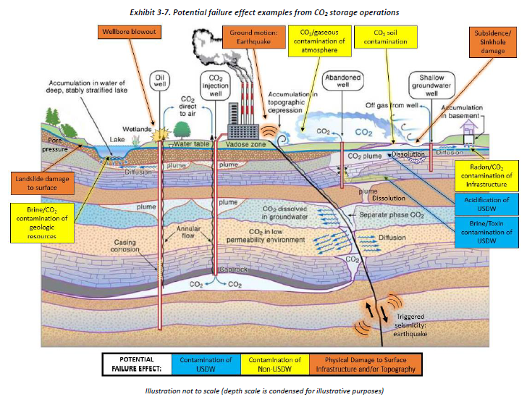
Containment
Taken from DOE NETL Report - Overview of Potential Failure Modes and Effects Associated with CO2 Injection and Storage Operations in Saline Formations
December 18, 2020 DOE/NETL-2020/2634

Slide 20


Legacy Wells
Type 2
Type 3
Type 4
Type 5
Type 6
UIC Class 6 Well
Type 7
Type 8
Type 9
Legend
Open Hole
USDW
Casing
Cement
USDW
Coal
Prod. Formations
Depth in miles
Perforations
Tubing
Primary Seal
Cement Plug
Seal
Prod. Formation
Reservoir
Storage Reservoir
CO₂ Plume
Packer
CO₂ Plume
Not drawn to scale.
Distance in Miles
Patent Pending
Possible Crossflow through the improperly plugged abandoned wells penetrating confining zone

Slide 21
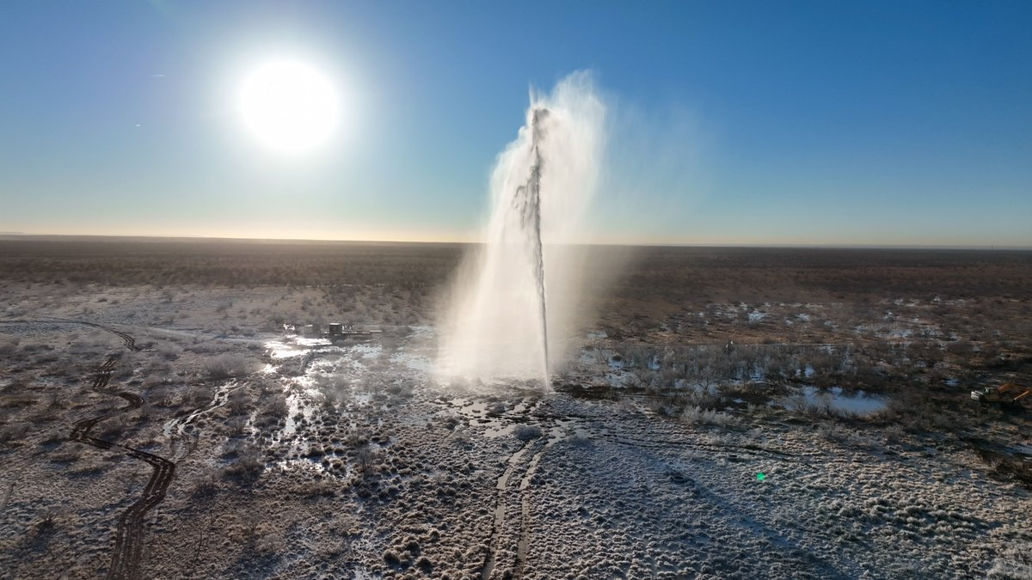
Crane County, Texas
January 2022

Slide 22

Stronger with Stogner
Please vote early starting tomorrow
RRC Commissioner Candidate
Campaign Ad

Slide 23

Assumptions Common to the Examples
Thick, pervasive, basal sandstone (single geologic formation)
No known minerals; natural gas storage
Few wellbore penetrations
Extensive, thick clay-rich shale caprock
Deep: greater cementation lower p&p
Examples are chronological advancement from a regional study to active injection

Slide 24
Example SRMS Applications

Slide 25
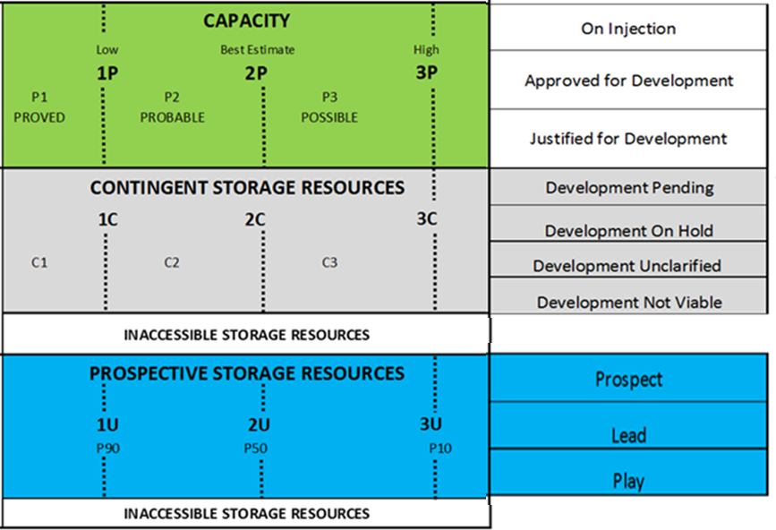
Regional Assessment: Notional Project
Purpose: storage potential
Notional project:
  Total regional emissions from stationary sources
  Fully developed infrastructure
Volumetric approach
  Pore volume with storage efficiency
  Single value
Boundaries:
  Perimeter: State lines; Fresh water
  Depth: Min-density of CO₂; max-low φ
Outcome:
  General Geographical area for a site
  Estimate: 800 Gtonnes (single value)
Classification: Prospective Storage Resources – Play
Categorization: 800 Gtonnes – 3U

Slide 26
Regional Assessment: Notional Project
Use of New Data and New Analysis
Classification: Prospective Storage Resources – Prospect
Categorization: 25 Gt – 1U; 50 Gt – 2U; 100 Gt – 3U
Objective: storage potential, site screening
Volumetric, GIS approach
  Efficiency: displacement, and net geologic attributes
  High, medium, low values (E= 1-4%)
Boundaries:
  Perimeter: regional dip; Fresh water
  Depth: Min-density of CO₂; max-low φ
Outcome:
  General Geographical area for a site
  Storing on regional dip
  Estimate: 25-100 Gtonnes

Slide 27
Site Selected, Well Drilled, Awaiting Management Commitment
Purpose: assess storage site for single well injection and site’s CO₂ emissions
Storage Project Status (at time of assessment)
  Site CO₂ emissions: 3,000 tpd
  Capture facility: 1,000 tpd, 25 yr life
  Single injection well
  Management commitment NOT finalized
Simulation: 8,000 tpd, well’s max injection rate
Boundaries: Storage rights and real estate ownership
Outcome (Table):
Project | Class | Subclass | Comment | Stor Quanty | Category | Comment
Facility | Contingent SR | Development Pending | No Management commitment | 9 Mt | 1C | Small facility
Site | Contingent SR | Development Pending | No Management commitment | 30 Mt | 2C | Total site emissions
Well | Contingent SR | Development Pending | No management commitment | 70 Mt | 3C | High estimate based on well

Slide 28
Active Injection: Defined, Management Approved Project
Purpose: Assess active project(s)
Final Project
  Infrastructure purchased: 1,000 tpd
  Management commitment: 12 years
Planned Project Expansion
  Management commitment: 2,000 tpd
Outcome (table)
Project | Class | Subclass | Comment | Stor Quanty | Category | Comment
Final | Capacity | On Injection | Management commitment | 4 Mt | Proved Developed Injecting, 1P | Active injection, equip. available
Planned | Capacity | Approved for Development | Management commitment | 8 Mt | Proved Undeveloped, 1P | Investment required
Site | Contingent SR | Development Unclarified | No management commitment | 58 Mt | 2C | Best estimate

Slide 29
Other Considerations
Status
Risk/Maturity
Prices
Estimation Methods

Slide 30
Project Maturity Subclass | Capacity Status Subdivisions
 | Developed Injecting Capacity | Developed Noninjecting Capacity | Undeveloped Capacity
On Injection | Proved Developed Injecting Capacity Probable Developed Injecting Capacity Possible Developed Injecting Capacity | Proved Developed Noninjecting Capacity Probable Developed Noninjecting Capacity Possible Developed Noninjecting Capacity | Proved Undeveloped Capacity Probable Undeveloped Capacity Possible Undeveloped Capacity
Approved for Development | - | Proved Developed Noninjecting Capacity Probable Developed Noninjecting Capacity Possible Developed Noninjecting Capacity | Proved Undeveloped Capacity Probable Undeveloped Capacity Possible Undeveloped Capacity
Justified for Development | - | - | Proved Undeveloped Capacity Probable Undeveloped Capacity Possible Undeveloped Capacity

Slide 31
Classification | Containment: Wellbores | Containment: Geological
Prospective Storage Resources: Play | Identify wellbores that penetrate the assessment area. | Identify caprocks (primary and secondary), all major faults and structures, and geologic formation limits.
Prospective Storage Resources: Lead | Use wellbore proxies (e.g., depth, age, historical usage, number of wellbores) to determine the likelihood of containment. | Use geologic proxies (e.g., thickness and lithology) and analog data to infer caprock containment.
Prospective Storage Resources: Prospect | Obtain and check well records and operator’s standard operating practices for the stated wellbore plug depths, cement tops behind casing, and material types. Evaluate containment for each well (based on records), specifically with regards to barriers and the caprock. | Conduct geologic and geomechanical assessment of fault seal using available data; investigate containment, specifically pressure build-up and migration, using a simple dynamic model.
Contingent Storage Resources | Assess barriers (integrity and depth relative to geologic containment) effect on storable quantities. If remediation is necessary, add remediation strategies and cost estimates to project development plans. | Update geologic containment assessments using additional data and evolving project description.
Capacity | Demonstrate acceptable containment risk for storable quantities (including demonstration to regulatory authorities).

Slide 32
Estimating Storable Quantities
Traps
  Geological Structure or Stratigraphic
  Residual trapping
  Solubility trapping
  Mineral trapping
Methods
  Analog
  Volumetric (Storage Efficiency based on type)
  Material balance
  Simulation
  Performance based
Examples given

Slide 33
Other Economic Factors – Minimal Experience
Prices
  Project
  Stand alone
Custody transfer
  Depends on project
  Impurities
Entitlement
  Ownership of pore space
    Elevated pore pressure area
    Nearby projects
    Leases / PSC ?

Slide 34
Summary of SRMS Applications Examples
SRMS intended use is in the context of commercial storage projects
  Specific project definition directly influences storable quantities
  Notional project acceptable for large scale resource assessments
Prospective vs. Contingent Storage Resources
  Prospective: no well available for assessment
  Contingent: well assessed and projected to meet project goals
Capacity
  Used solely for commercial/ economic projects
  Status indicates degree of certainty in terms of geologic and project parameters
Classification and Categorization of storable quantities is subjective

Slide 35
SRMS Usage: Expected Outcomes
Provides guidelines for developing commercial storage projects.
Gives standardized terminology and definitions in commercial contracts similar to other subsurface commodity industries
Assessors and stakeholders have a methodology to follow to make comparisons between projects.
System that relates project certainty and geologic certainty to a storable quantity estimate

Slide 36
Country | Stored | Capacity | Contingent | Inaccessible Sub-commercial | Prospective | Inaccessible Undiscovered | Total
Australia | 0.001 | 0.120 | 17.956 | 13.4 | 470.953 | 0 | 502.43
United States | 0.003 | 0.004 | 55.288 | 202.691 | 7803.826 | 0 | 8061.812
United Kingdom | 0 | 0 | 17.111 | 0 | 60.565 | 0 | 77.676
South Korea | 0 | 0 | 0 | 0.021 | 201.281 | 2.06 | 203.362
Pakistan | 0 | 0 | 0 | 1.702 | 0 | 30 | 31.702
Norway | 0.026 | 0.0368 | 39.813 | 16.2 | 37.55 | 0 | 93.626
Mexico | 0 | 0 | 0 | 89.54 | 0 | 11.26 | 100.8
Malaysia | 0 | 0 | 0 | 0 | 0 | 149.573 | 149.573
Japan | 0 | 0 | 5.226 | 31 | 116.04 | 0 | 152.266
Indonesia | 0 | 0 | 0 | 2.46 | 0 | 13.395 | 15.855
India | 0 | 0 | 0 | 0.835 | 0 | 63.3 | 64.135
Germany | 0 | 0 | 0 | 0 | 0.108 | 0 | 0.108
Denmark | 0 | 0 | 0.093 | 0 | 1.536 | 0 | 1.629
China | 0 | 0 | 4.795 | 5.736 | 0 | 3066.9 | 3077.431
Canada | 0.005 | 0.056 | 25.625 | 18.016 | 360.27 | 0 | 403.972
Bangladesh | 0 | 0 | 0 | 1.133 | 0 | 20 | 21.133
Brazil | 0.001 | 0 | 0 | 2.469 | 0 | 0 | 2.47
Total | 0.036 | 0.2168 | 165.907 | 385.203 | 9052.129 | 3356.488 | 12959.98
Total Storage Resources in GT (Gigatonnes)
Courtesy: 2021 Global Status of CCS Report
Courtesy: 2021 Global Status of CCS Report

Slide 37
Acknowledgements
Society of Petroleum Engineers’ members are leading and organizing the SRMS guidelines development with support of SPE staff. SPE is the largest individual-member organization serving managers, engineers, scientists and other professionals worldwide in the upstream segment of the oil and gas industry.
The Oil and Gas Climate Initiative supports the SRMS development. Their mission is to accelerate actions that mitigate greenhouse gas emissions from the industry’s operations, while still meeting the world’s energy needs.
CarbonSAFE Macon County project (US DOE DE-FE0029381) is funded by the US Department of Energy (USDOE) through the National Energy Technology Laboratory (NETL)).
The Midwest Geological Sequestration Consortium is funded by the USDOE through the NETL via the Regional Carbon Sequestration Partnership Program (contract number DE-FC26-05NT42588) and by a cost share agreement with the Illinois Dept of Commerce and Economic Opportunity, Off. of Coal Development through the Illinois Clean Coal Institute.

Slide 38
References
“The CO₂ storage resources management system (SRMS): toward a common approach to classifying, categorizing, and quantifying storage resources”, Scott M. Frailey, George J. Koperna, Owain Tucker, 14th International Conference on Greenhouse Gas Control Technologies (GHGT-14), October 21-15, 2018, Australia
“The genesis of the CO₂ storage resource management system (SRMS)”, Scott M. Frailey, Owain Tucker, George J. Koperna, 2016, 13th International Conference on Greenhouse Gas Technologies (GHGT-13) Proceedings. Energy Procedia 114: 4262-4269.

